Slide 1
TERMS AND CONDITIONS
These PowerPoint slides are a tool for lecturers, and as such:
YOU MAY add content to the slides, delete content from the slides, print out the slides, and save the slides onto your computer or server.
YOU MAY NOT resell, reproduce or redistribute the content in any form whatsoever, without prior written permission from the copyright holder.
© Troupant Publishers (Pty) Ltd, 2016
Selected images used under licence from Shutterstock.com

Slide 2
Engineering Systems
NQF Level 2

Slide 3
Routine maintenance
Topic 3

Slide 4
Planning and preparing for routine maintenance
Module 15

Slide 5
Maintenance
Unit 15 .1

Slide 6
Routine maintenance and preventative maintenance
Routine maintenance
Performing basic checks and minor adjustments that are necessary before the equipment is put into operation or service.

Slide 7
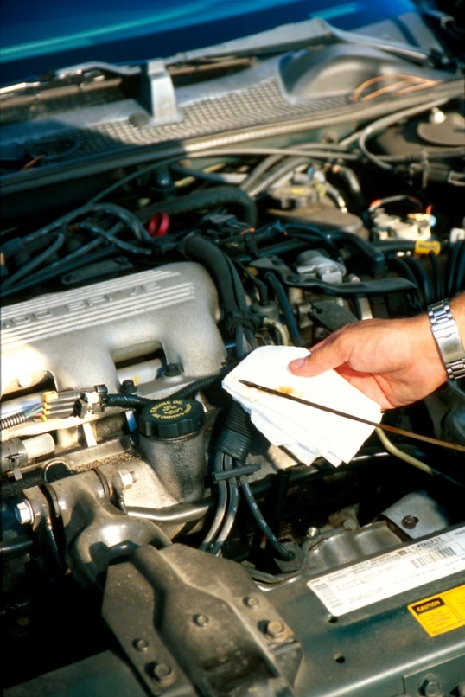
Routine maintenance and preventative maintenance
Routine maintenance
Figure 15.1 Checking the oil level of a car on a weekly basis

Slide 8
Routine maintenance and preventative maintenance
Preventative maintenance (PM)
The practice of maintaining equipment on a regular schedule based on elapsed time or meter readings.

Slide 9
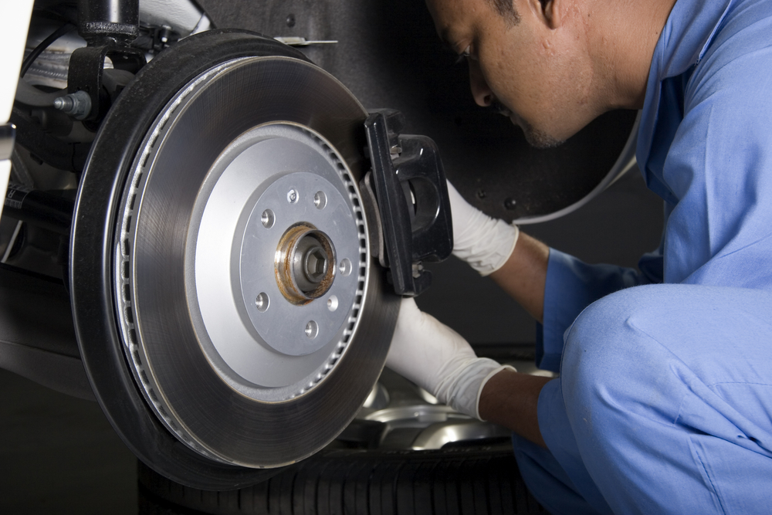
Routine maintenance and preventative maintenance
Preventative maintenance
(PM)
Figure 15.2 Replacing brake pads on a car

Slide 10
Planning a routine maintenance programme
Maintain a safe working environment.
Establish a scheduling process.
Divide the organisation into sections and subsections.
Develop an equipment list.
Develop routine maintenance instructions.
Monitor the effectiveness of the programme.

Slide 11
Developing routine maintenance instructions
Figure 15.4 Example of a checklist for routine maintenance instructions

Slide 12
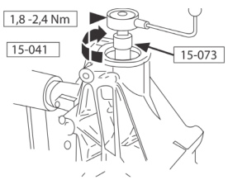
Developing routine maintenance instructions
Develop a checklist
Figure 15.5 Manual showing torque setting

Slide 13
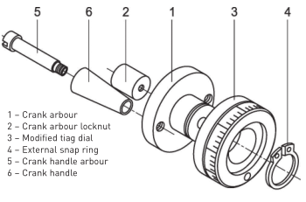
Developing routine maintenance instructions
Keep records
Figure 15.6 Names and descriptions of parts

Slide 14
Monitoring the effectiveness of the programme
Check the gap between the tool rest and the wheel. It should be 2 mm.
Use a feeler gauge to adjust if necessary.

Slide 15
Benefits of a routine maintenance programme
There is less equipment downtime.
The work environment is safer for personnel.
Fewer repairs are required.
The equipment lasts longer.
Repair costs are cheaper compared to breakdown costs.
There are fewer product rejects and quality control is better.

Slide 16
Benefits of a routine maintenance programme
Repair costs are reduced over time.
Less overtime pay has to be paid to maintenance staff to perform unscheduled repairs.
Spare parts can be kept to a minimum.
Workers’ relationships are better.

Slide 17
VIDEO: Thobejane studying

Slide 18
Performing pre- operational inspections and preparing for routine maintenance
Unit 15 .2

Slide 19
Mechanical inspections
Examine the nameplate data to see whether all the data is legible.
If a lifting device is provided for handling the motor, inspect it for cracks.
Check the motor foundation mounting for rigidity to prevent excessive vibration.

Slide 20
Mechanical inspections
Check the alignment of the motor with the driven unit.
Check that all bolts are securely in place and tight. Also check the terminal connections and assembly screws.
Check that the guards are secured and in place.

Slide 21
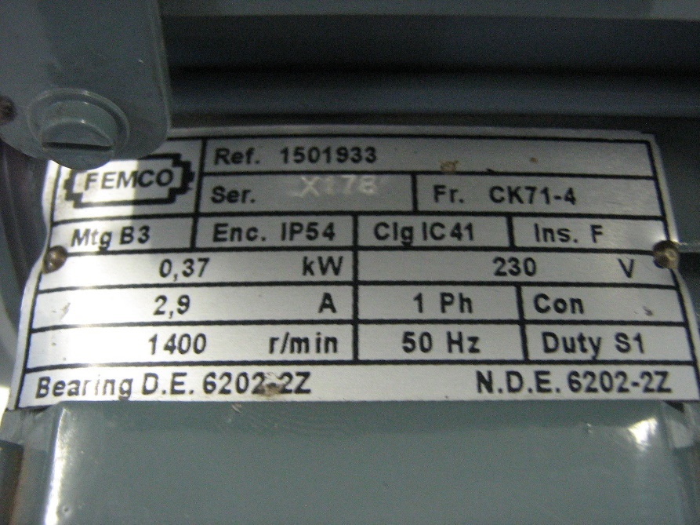
Mechanical inspections
Figure 15.7 A typical motor nameplate

Slide 22
Mechanical inspections
Check that the correct mounting holes are used.
Check that the pulley, sprocket or gear used in the drive is located on the shaft as close to the shaft shoulder as possible.
Check the pulleys to ensure that the belt runs true.
Check if the belt is tight enough to prevent slippage.
Check if the rotor turns freely by hand.
Check the shaft keyway for damage.

Slide 23
Mechanical inspections
Figure 15.8 Mounting holes for motor

Slide 24
Mechanical inspections
Check for damaged gears.
Check the shaft bearing and end play by moving the shaft sideways.
Check the motor frame, end shields and base plate for cracks.
Check for missing grease nipple nuts and bolts.

Slide 25
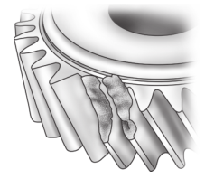
Mechanical inspections
Figure 15.9 Damaged gears

Slide 26
Inspecting belt drives
Figure 15.10 Grease spilled onto a guard

Slide 27
Inspecting belt drives
Look and listen for any unusual vibration or sound while observing the guarded drive in operation.
Check whether the belt is hot.
Look for oil or grease dripping from the guard.
Check the motor mountings for tightness.
Check the take-up slots or rails to see that they are clean and lightly Lubricated.

Slide 28
Inspecting chain drives
Check chains regularly for alignment.
Check chains for excessive slack.
Do not install a new chain on sprockets that are badly worn.

Slide 29
Inspecting chain drives
Figure 15.11 Check chains for alignment

Slide 30
Preparing machinery or equipment for routine maintenance
Cleaning a chain drive
Remove the chain from the sprockets.
Wash it in a cleaning solvent.
After draining the cleaning solvent, inspect the chain for wear or rust.
Then soak the chain in oil to restore the internal lubrication.
Hang the chain over a rod to drain off the excess lubricant.
While the chain is off the sprockets, also wash the sprockets with a cleaning solvent and check for wear.

Slide 31
Preparing machinery or equipment for routine maintenance
Cleaning machinery or equipment
The three main methods:
Air pressure.
Vacuuming.
Cleaning solvent.

Slide 32
Cleaning machinery or equipment
Air pressure.
Vacuuming.
Cleaning solvent.

Slide 33
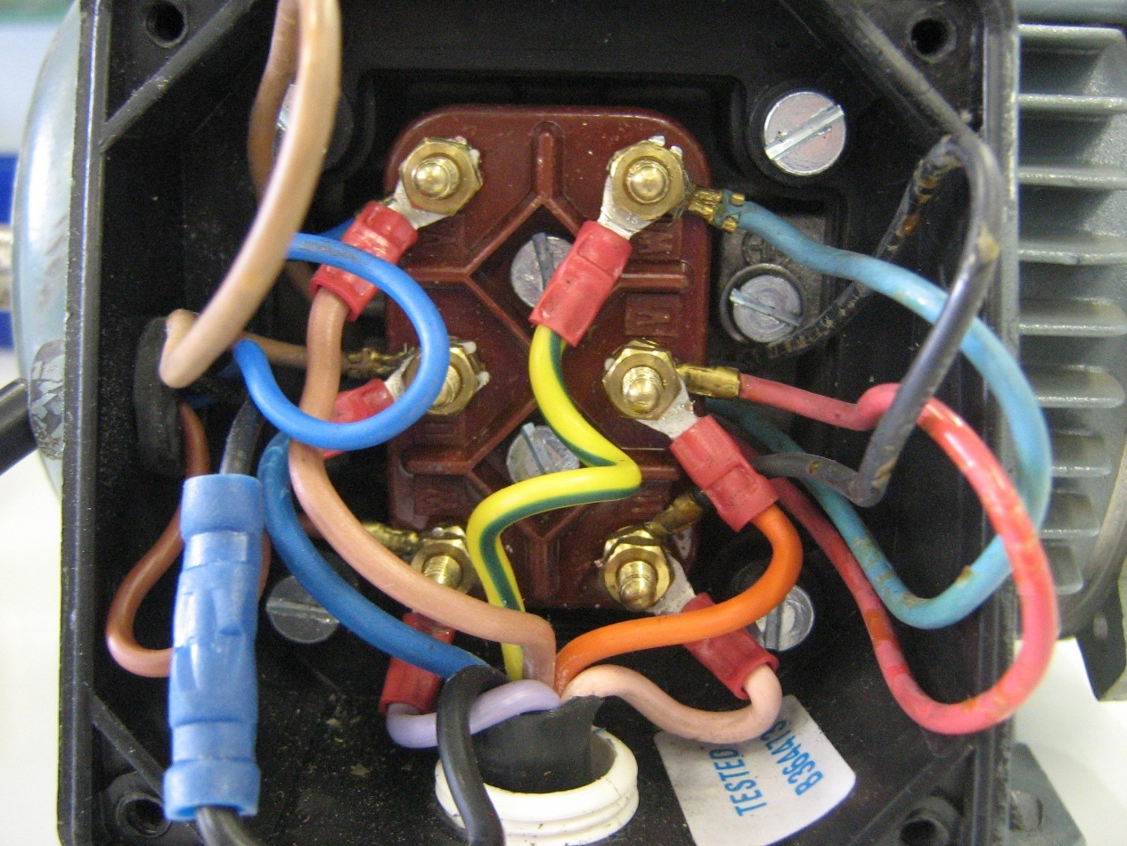
Labelling of motor connections
Figure 15.12 Terminal wires

Slide 34
Cable markers
Marker ties.
Identification cable ties.
Marker plates.
Clip-on markers.
Figure 15.13 Using cable markers to identify terminals

Slide 35
Troubleshooting flowcharts
Figure 15.13 Using cable markers to identify terminals

Slide 36
Troubleshooting flowcharts
Table 15.1 An example of a flowchart for a hydraulic system

Slide 37
Troubleshooting flowcharts
Table 15.2 Tools and their functions

Slide 38
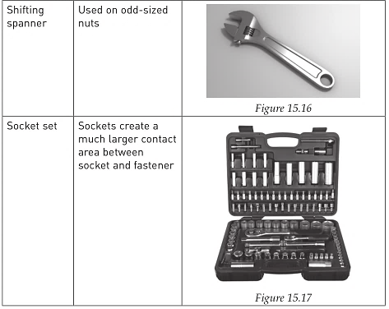
Troubleshooting flowcharts
Table 15.2 Tools and their functions (continued)

Slide 39
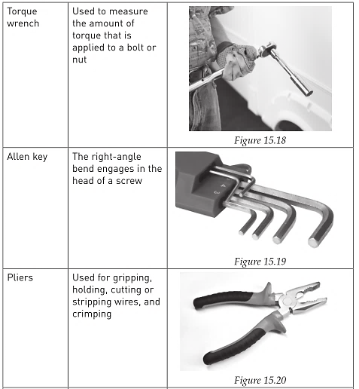
Trouble-shooting flowcharts
Table 15.2 Tools and their functions (continued)

Slide 40
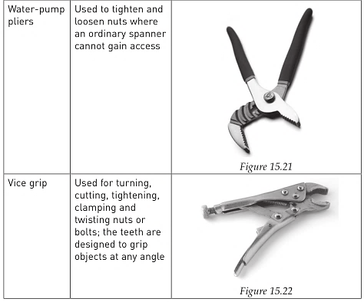
Troubleshooting flowcharts
Table 15.2 Tools and their functions (continued)

Slide 41
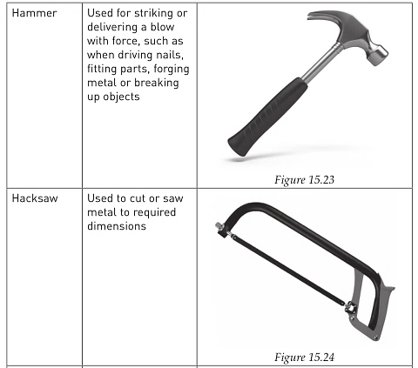
Troubleshooting flowcharts
Table 15.2 Tools and their functions (continued)

Slide 42
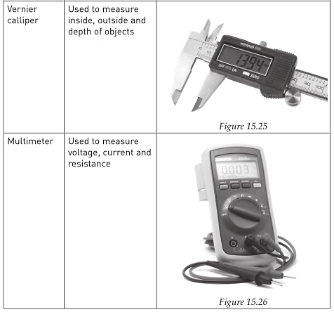
Troubleshooting flowcharts
Table 15.2 Tools and their functions (continued)

Slide 43
Summative assessment
Test your knowledge of this section by completing the Summative assessment (page 247 of your Student’s Book)

